Slide 1
Chapter 4
Relational Algebra
Basic Operations

Slide 2
What is an “Algebra”
Mathematical system consisting of:
  Operands --- variables or values from which new values can be constructed.
  Operators --- symbols denoting procedures that construct new values from given values.

Slide 3
Relational Algebra
Relational algebra operations work on one or more relations to define another relation without changing the original relations.
Both operands and results are relations, so output from one operation can become input to another operation.
Allows expressions to be nested, just as in arithmetic. This property is called closure.

Slide 4
Core Relational Algebra
Union, intersection, and difference, Division:
  Usual set operations, but both operands must have the same relation schema.
Selection: picking certain rows.
Projection: picking certain columns.
Products and joins: compositions of relations.
Renaming of relations and attributes.

Slide 5
Relational Algebra
Five basic operations in relational algebra: Selection, Projection, Cartesian product, Union, and Set Difference.
These perform most of the data retrieval operations needed.
Also have Join, Intersection, and Division operations, which can be expressed in terms of 5 basic operations.

Slide 6
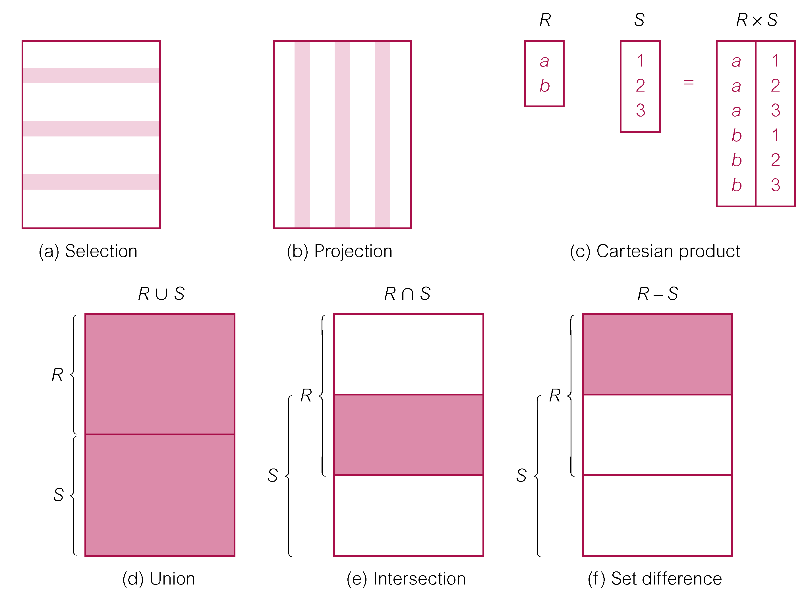
Relational Algebra Operations

Slide 7
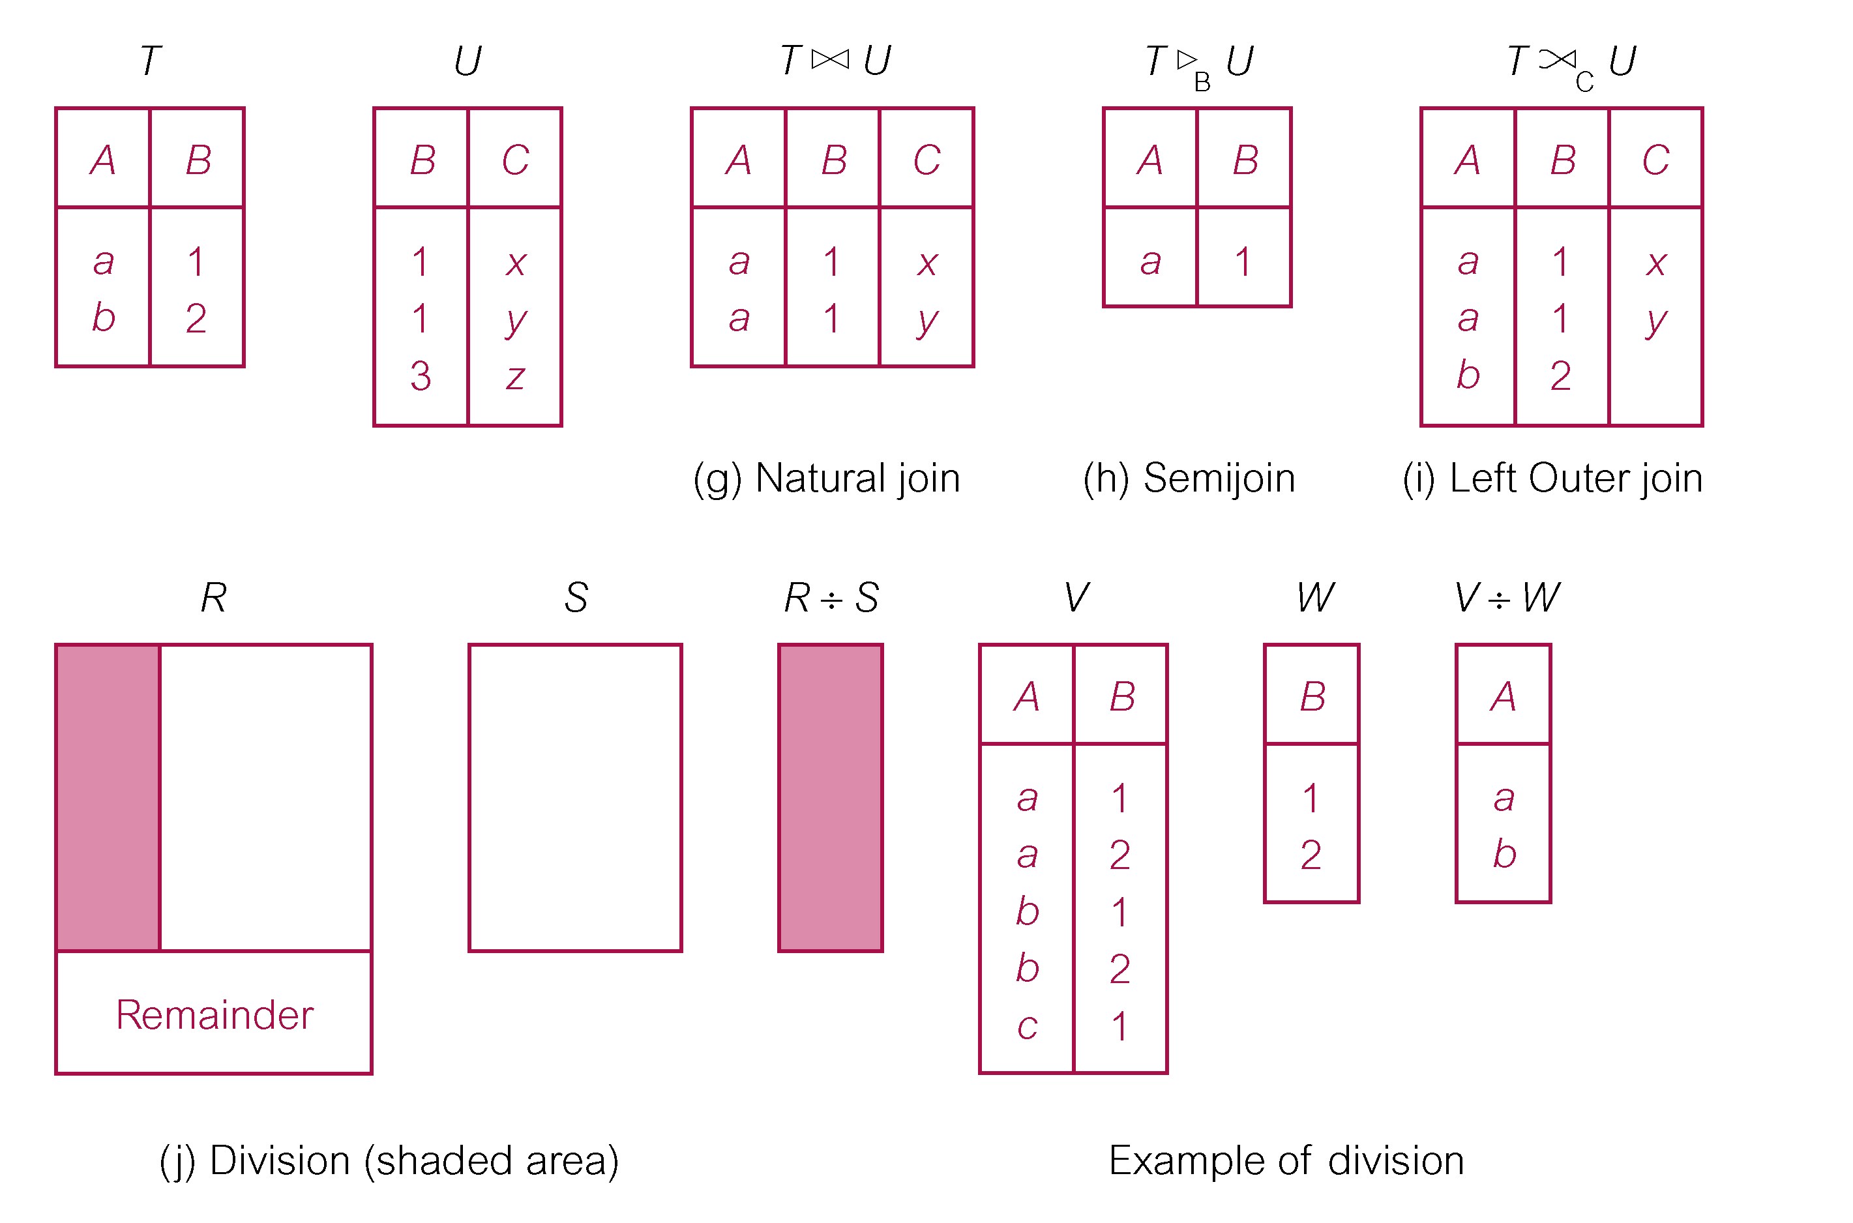
Relational Algebra Operations

Slide 8
Selection (or Restriction)
σ_{predicate} (R)
  Works on a single relation R and defines a relation that contains only those tuples (rows) of R that satisfy the specified condition (predicate).

Slide 9
Example: Selection
Relation Sells:
bar beer price
Joe’s Bud 2.50
Joe’s Miller 2.75
Sue’s Bud 2.50
Sue’s Miller 3.00
JoeMenu := σ_{bar=“Joe’s”}(Sells):
bar beer price
Joe’s Bud 2.50
Joe’s Miller 2.75

Slide 10
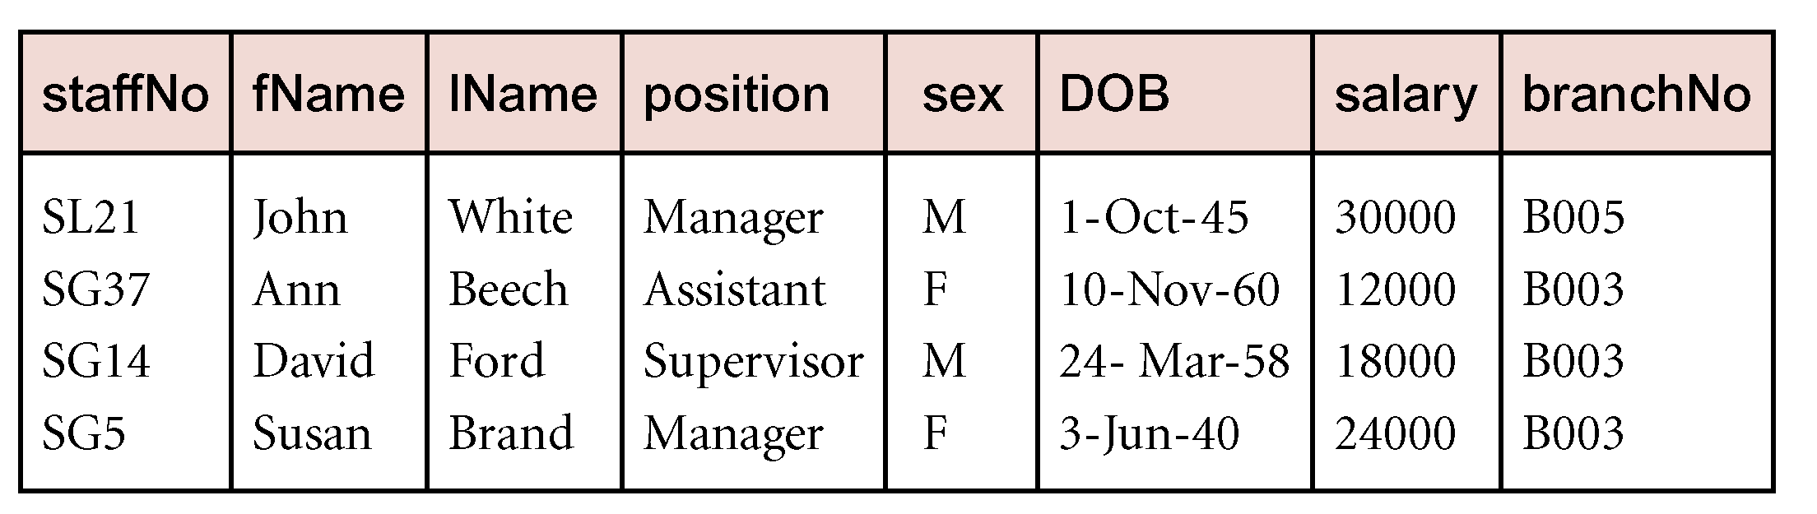
Example - Selection (or Restriction)
List all staff with a salary greater than £10,000.
  σ_{salary > 10000} (Staff)

Slide 11
Projection
Π_{col1, . . . , coln}(R)
  Works on a single relation R and defines a relation that contains a vertical subset of R, extracting the values of specified attributes and eliminating duplicates.

Slide 12
Example: Projection
Relation Sells:
bar beer price
Joe’s Bud 2.50
Joe’s Miller 2.75
Sue’s Bud 2.50
Sue’s Miller 3.00
Prices := π_{beer,price}(Sells):
beer price
Bud 2.50
Miller 2.75
Miller 3.00

Slide 13
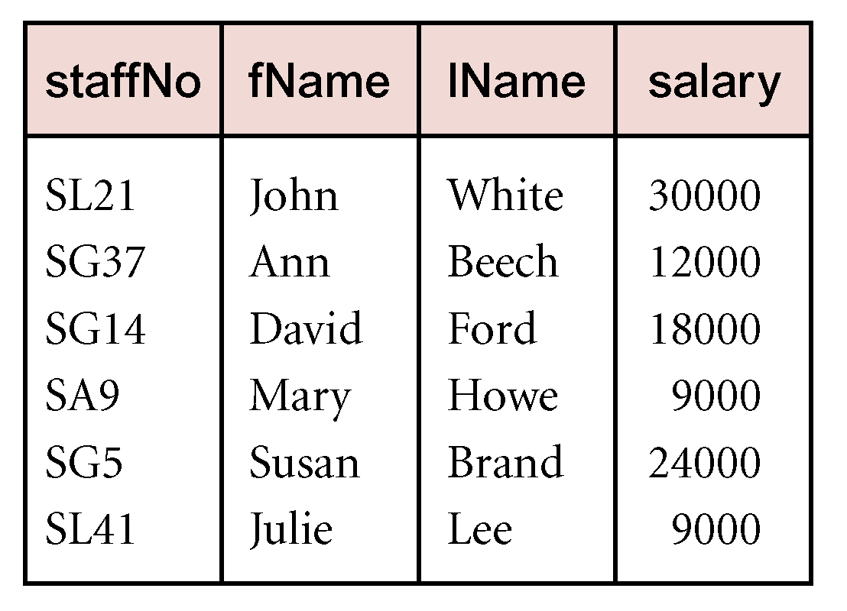
Example - Projection
Produce a list of salaries for all staff, showing only staffNo, fName, lName, and salary details.
  Π_{staffNo, fName, lName, salary}(Staff)

Slide 14
Union
R ∪ S
  Union of two relations R and S defines a relation that contains all the tuples of R, or S, or both R and S, duplicate tuples being eliminated.
  R and S must be union-compatible.
If R and S have I and J tuples, respectively, union is obtained by concatenating them into one relation with a maximum of (I + J) tuples.

Slide 15
example
R
S
A | B | C
1 | 2 | 3
4 | 5 | 6
7 | 8 | 9
A | B | C
7 | 8 | 9
4 | 5 | 6
5 | 1 | 12
A | B | C
1 | 2 | 3
4 | 5 | 6
7 | 8 | 9
5 | 1 | 12
R∪S result：

Slide 16
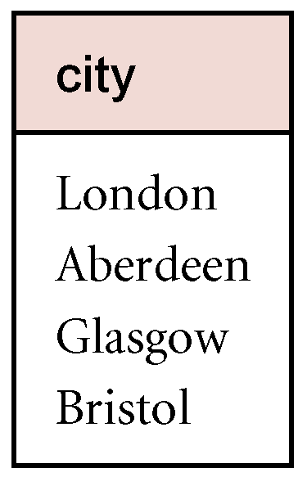
Example - Union
List all cities where there is either a branch office or a property for rent.
  Π_{city}(Branch) ∪ Π_{city}(PropertyForRent)

Slide 17
Set Difference
R – S
  Defines a relation consisting of the tuples that are in relation R, but not in S.
  R and S must be union-compatible.

Slide 18
example
R
S
A | B | C
1 | 2 | 3
4 | 5 | 6
7 | 8 | 9
A | B | C
7 | 8 | 9
4 | 5 | 6
5 | 1 | 12
R-S result：
A | B | C
1 | 2 | 3

Slide 19
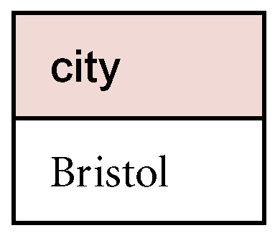
Example - Set Difference
List all cities where there is a branch office but no properties for rent.
  Π_{city}(Branch) – Π_{city}(PropertyForRent)

Slide 20
Intersection
R ∩ S
  Defines a relation consisting of the set of all tuples that are in both R and S.
  R and S must be union-compatible.
Expressed using basic operations:
  R ∩ S = R – (R – S)

Slide 21
R∩S =R-(R-S)
R∩S =S-(S-R)
R∩S
R-S
S-R

Slide 22
example
R
S
A | B | C
1 | 2 | 3
4 | 5 | 6
7 | 8 | 9
A | B | C
7 | 8 | 9
4 | 5 | 6
5 | 1 | 12
R∩S result：
A | B | C
4 | 5 | 6
7 | 8 | 9

Slide 23
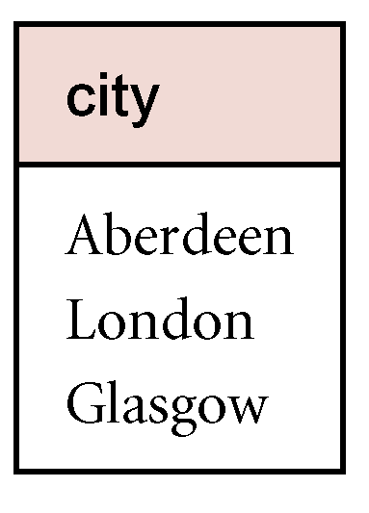
Example - Intersection
List all cities where there is both a branch office and at least one property for rent.
  Π_{city}(Branch) ∩ Π_{city}(PropertyForRent)

Slide 24
Cartesian product
R X S
  Defines a relation that is the concatenation of every tuple of relation R with every tuple of relation S.

Slide 25
Product
R3 := R1 Χ R2
  Pair each tuple t1 of R1 with each tuple t2 of R2.
  Concatenation t1t2 is a tuple of R3.
  Schema of R3 is the attributes of R1 and then R2, in order.
  But beware attribute A of the same name in R1 and R2: use R1.A and R2.A.

Slide 26
Example: R3 := R1 Χ R2
R1( A, B )
1 2
3 4
R2( B, C )
5 6
7 8
9 10
R3( A, R1.B, R2.B, C )
1 2 5 6
1 2 7 8
1 2 9 10
3 4 5 6
3 4 7 8
3 4 9 10

Slide 27
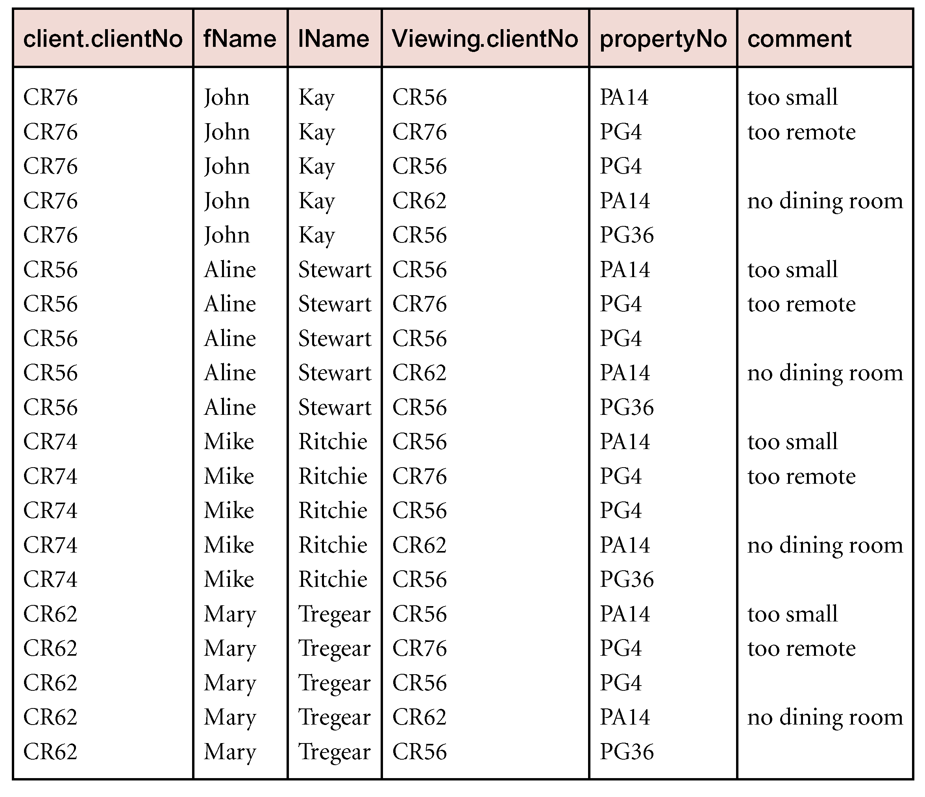
Example - Cartesian product
List the names and comments of all clients who have viewed a property for rent.
  (Π_{clientNo, fName, lName}(Client)) X (Π_{clientNo, propertyNo, comment} (Viewing))

Slide 28
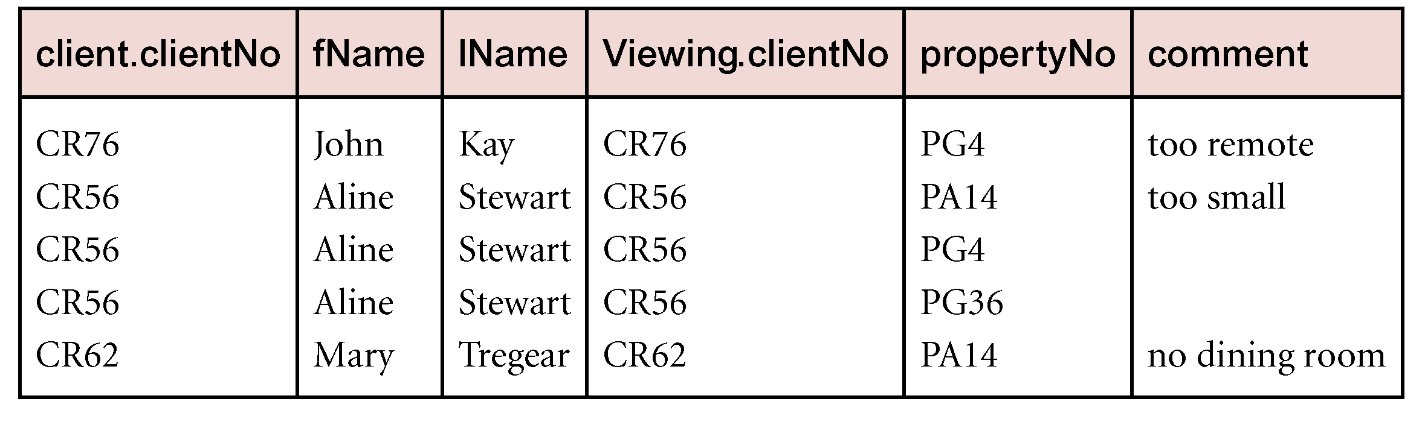
Example - Cartesian product and Selection
Use selection operation to extract those tuples where Client.clientNo = Viewing.clientNo.
  sClient.clientNo = Viewing.clientNo((Õ_{clientNo, fName, lName}(Client)) Χ (∏_{clientNo, propertyNo, comment}(Viewing)))
Cartesian product and Selection can be reduced to a single operation called a Join.

Slide 29
Join Operations
Join is a derivative of Cartesian product.
Equivalent to performing a Selection, using join predicate as selection formula, over Cartesian product of the two operand relations.

Slide 30
Join Operations
Various forms of join operation
  Theta join
  Equijoin (a particular type of Theta join)
  Natural join
  Outer join
  Semijoin

Slide 31
Theta join (θ-join)
R _{F}S
  Defines a relation that contains tuples satisfying the predicate F from the Cartesian product of R and S.
  The predicate F is of the form R.a_{i} θ S.b_{i} where θ may be one of the comparison operators (<, ≤, >, ≥, =, ≠).

Slide 32
Theta join (θ-join)
Can rewrite Theta join using basic Selection and Cartesian product operations.
    R _{F}S = σ_{F}(R Χ S)
Degree of a Theta join is sum of degrees of the operand relations R and S. If predicate F contains only equality (=), the term Equijoin is used.

Slide 33
Example: Theta Join
Sells( bar, beer, price ) Bars( name, addr )
Joe’s Bud 2.50 Joe’s Maple St.
Joe’s Miller 2.75 Sue’s River Rd.
Sue’s Bud 2.50
Sue’s Coors 3.00
BarInfo := Sells ⋈_{Sells.bar = Bars.name} Bars
BarInfo( bar, beer, price, name, addr )
Joe’s Bud 2.50 Joe’s Maple St.
Joe’s Miller 2.75 Joe’s Maple St.
Sue’s Bud 2.50 Sue’s River Rd.
Sue’s Coors 3.00 Sue’s River Rd.

Slide 34
Example - Equijoin
List the names and comments of all clients who have viewed a property for rent.
  (Π_{clientNo, fName, lName}(Client)) Client.clientNo = Viewing.clientNo (Π_{clientNo, propertyNo, comment}(Viewing))

Slide 35
Natural join
R S
  An Equijoin of the two relations R and S over all common attributes x. One occurrence of each common attribute is eliminated from the result.

Slide 36
Example: Natural Join
Sells( bar, beer, price ) Bars( bar, addr )
Joe’s Bud 2.50 Joe’s Maple St.
Joe’s Miller 2.75 Sue’s River Rd.
Sue’s Bud 2.50
Sue’s Coors 3.00
BarInfo := Sells ⋈ Bars
Note: Bars.name has become Bars.bar to make the natural
join “work.”
BarInfo( bar, beer, price, addr )
Joe’s Bud 2.50 Maple St.
Joe’s Milller 2.75 Maple St.
Sue’s Bud 2.50 River Rd.
Sue’s Coors 3.00 River Rd.

Slide 37
自然联接与等值联接的区别：
（1）在做自然联接的两个关系中，要求值相等的属性名也必须相等，而在等值联接中不要求值相等的属性名相等。
（2）在自然联接的结果中，去掉重复的属性名，而在等值联接的结果中不去掉重复的属性名。
★若两个关系没有公共属性，则其自然联接就转化为笛卡尔积操作。
下例说明自然联接和等值联接的区别

Slide 38
R
S
A | B | C
a1 | b1 | 5
a1 | b2 | 6
a2 | b3 | 8
a2 | b4 | 12
B | E
b1 | 3
b2 | 7
b3 | 10
b3 | 2
b5 | 2
equijoin
Natural join
A | R.B | C | S.B | E
a1 | b1 | 5 | b1 | 3
a1 | b2 | 6 | b2 | 7
a2 | b3 | 8 | b3 | 10
a2 | b3 | 8 | b3 | 2
A | B | C | E
a1 | b1 | 5 | 3
a1 | b2 | 6 | 7
a2 | b3 | 8 | 10
a2 | b3 | 8 | 2

Slide 39

Natural join
R
S
R S
A | B | C
a | b | c
d | b | c
b | b | f
c | a | d
B | C | D
b | c | d
b | c | e
a | d | b
A | B | C | D
a | b | c | d
a | b | c | e
d | b | c | d
d | b | c | e
c | a | d | b

Slide 40
equijoin
R S
R S
R
S
3=2
2=1∧3=2
A | B | C
a | b | c
d | b | c
b | b | f
c | a | d
B | C | D
b | c | d
b | c | e
a | d | b
A | R.B | R.C | S.B | S.C | D
a | b | c | b | c | d
a | b | c | b | c | e
d | b | c | b | c | d
d | b | c | b | c | e
c | a | d | a | d | b
R S
1=1
A | R.B | R.C | S.B | S.C | D
b | b | f | b | c | d
b | b | f | b | c | e
a | b | c | a | d | b

Slide 41
Example: Self-Join
Using Sells(bar, beer, price), find the bars that sell two different beers at the same price.
Strategy: by renaming, define a copy of Sells, called S(bar, beer1, price). The natural join of Sells and S consists of quadruples (bar, beer, beer1, price) such that the bar sells both beers at this price.

Slide 42
The Tree
π_{bar}
σ_{beer != beer1}
⋈
ρ_{S(bar, beer1, price)}
Sells
Sells

Slide 43
Outer join
To display rows in the result that do not have matching values in the join column, use Outer join.
R S
  (Left) outer join is join in which tuples from R that do not have matching values in common columns of S are also included in result relation.

Slide 44
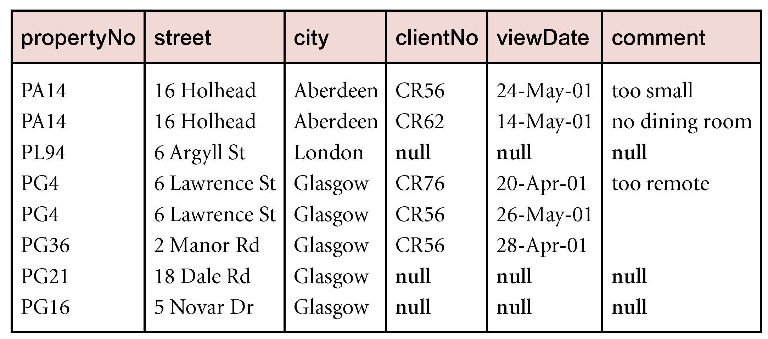
Example - Left (Right, Full) Outer join
Produce a status report on property viewings.
  Π_{propertyNo, street, city}(PropertyForRent)
  Viewing

Slide 45
Outer join
在关系R和S做自然联接时，我们选择两个关系在公共属性上值相等的元组构成新关系的元组。
关系R中某些元组有可能在S中不存在公共属性上值相等的元组，造成R中的这些元组的值在操作时被舍弃。由于同样的原因。S中某些元组也有可能被舍弃。

Slide 46

外联接
如果关系R和S做自然联接时，把R和S中原该舍弃的元组也保留在新关系中，同时在这些元组新增加的属性上填上空值（Null）,这种操作称为“外联接”操作。用如下符号表示：
R S

Slide 47
外联接的例子
R
S
R S
A | B | C
a | b | c
b | b | f
c | a | d
B | C | D
b | c | d
b | c | e
a | d | b
e | f | g
A | B | C | D
a | b | c | d
a | b | c | e
c | a | d | b
R S
A | B | C | D
a | b | c | d
a | b | c | e
c | a | d | b
b | b | f | null
null | e | f | g

Slide 48

左外联接
如果关系R和S做自然联接时，只把R中原该舍弃的元组放到新关系中，那么这种操作称为“左外联接”操作。用如下符号表示：
R S

Slide 49
左外联接的例子
R
S
R S
A | B | C
a | b | c
b | b | f
c | a | d
B | C | D
b | c | d
b | c | e
a | d | b
e | f | g
A | B | C | D
a | b | c | d
a | b | c | e
c | a | d | b
R S
R S
A | B | C | D
a | b | c | d
a | b | c | e
c | a | d | b
b | b | f | null
null | e | f | g
A | B | C | D
a | b | c | d
a | b | c | e
c | a | d | b
b | b | f | null

Slide 50

右外联接
如果关系R和S做自然联接时，只把S中原该舍弃的元组放到新关系中，那么这种操作称为“右外联接”操作。用如下符号表示：
R S

Slide 51
右外联接的例子
R
S
R S
A | B | C
a | b | c
b | b | f
c | a | d
B | C | D
b | c | d
b | c | e
a | d | b
e | f | g
A | B | C | D
a | b | c | d
a | b | c | e
c | a | d | b
R S
R S
A | B | C | D
a | b | c | d
a | b | c | e
c | a | d | b
b | b | f | null
null | e | f | g
A | B | C | D
a | b | c | d
a | b | c | e
c | a | d | b
null | e | f | g

Slide 52
Division
R ÷ S
  Defines a relation over the attributes C that consists of set of tuples from R that match combination of every tuple in S.
Expressed using basic operations:
  T₁ ← Π_{C}(R)
  T₂ ← Π_{C}((S X T₁) – R)
  T ← T₁ – T₂

Slide 53
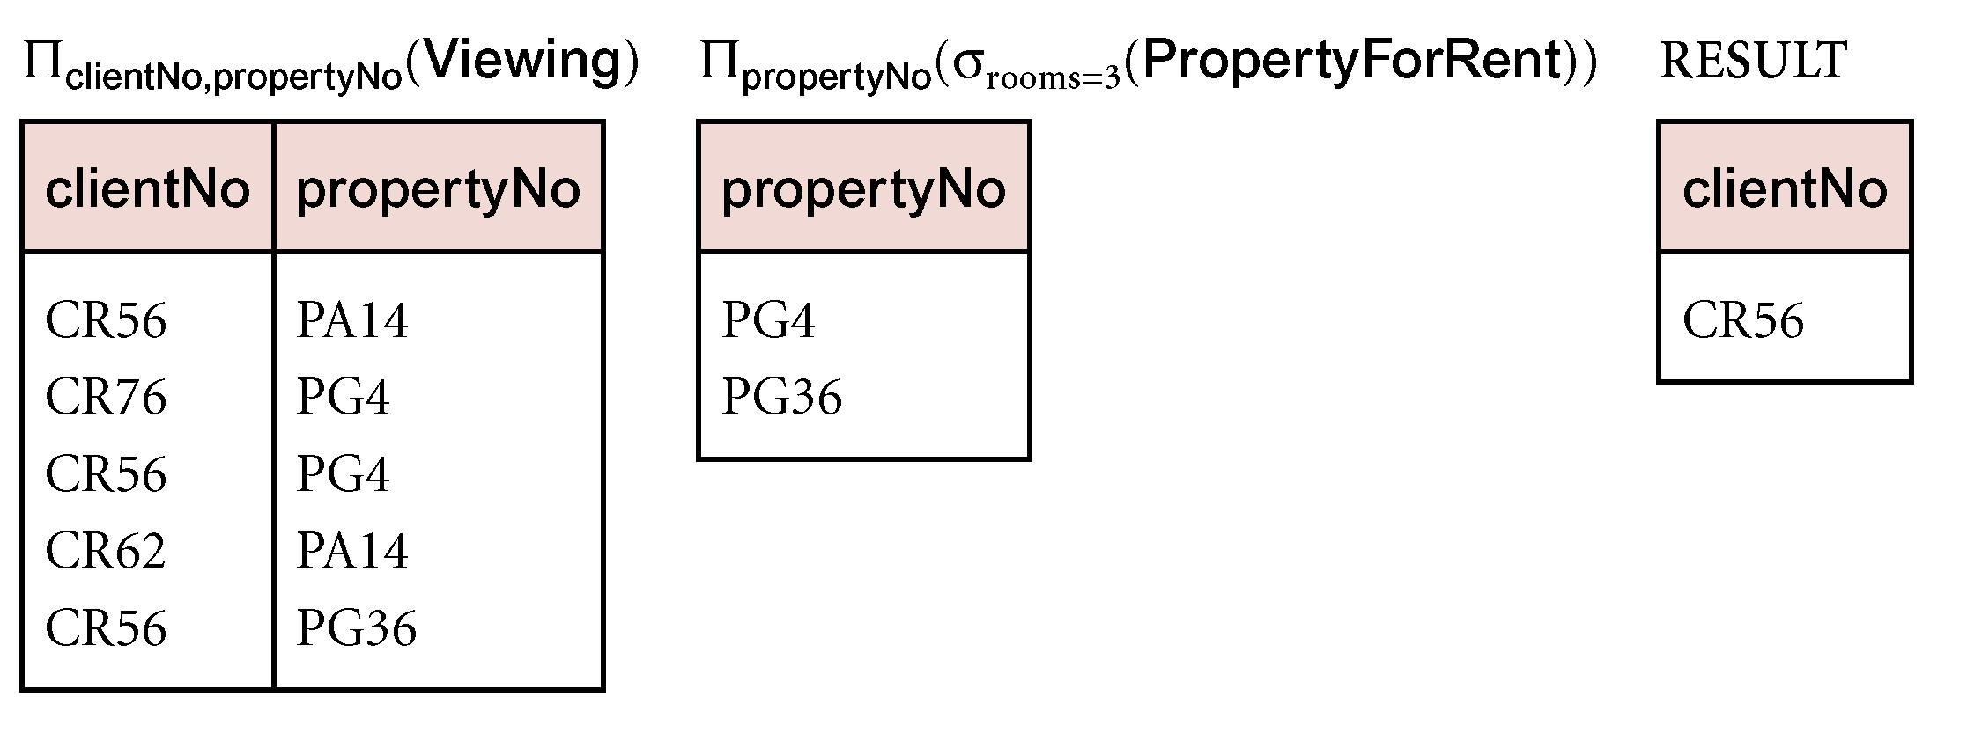
Example - Division
Identify all clients who have viewed all properties with three rooms.
  (Π_{clientNo, propertyNo}(Viewing)) ÷ (Π_{propertyNo}(σ_{rooms = 3} (PropertyForRent)))

Slide 54
Example
X
Y
Y
R
S
A | B | C | D
a | b | c | d
a | b | e | f
a | b | d | e
b | c | e | f
e | d | c | d
e | d | e | f
C | D
c | d
e | f
当x=(b,c)时，其象集Y_{x}为：
C | D
e | f

Slide 55
当x=(a,b)时，其象集Y_{x}为：
当x=(e,d)时，其象集Y_{x}为：
C | D
c | d
e | f
d | e
C | D
c | d
e | f
X
R÷S的结果为：
A | B
a | b
e | d

Slide 56
Example2 R÷S
X
Y
Y
Z
R
A | B | C
a₁ | b₁ | c₂
a₂ | b₃ | c₇
a₃ | b₄ | c₆
a₁ | b₂ | c₃
a₄ | b₆ | c₆
a₂ | b₂ | c₃
a₁ | b₂ | c₁
S
B | C | D
b₁ | c₂ | d₁
b₂ | c₁ | d₁
b₂ | c₃ | d₂
(1)当x=(a₁)时
其象集为
B | C
b₁ | c₂
b₂ | c₃
b₂ | c₁
X可以取值为{a₁,a₂,a₃,a₄}

Slide 57
(2)当x=(a₂)时
(3)当x=(a₃)时
(4)当x=(a₄)时
其象集为
其象集为
其象集为
B | C
b₃ | c₇
b₂ | c₃
B | C
b₄ | c₆
B | C
b₆ | c₆
R÷S的结果为：
S在(B,C)Y上的投影为
X
B | C
b₁ | c₂
b₂ | c₁
b₂ | c₃
A
a₁

Slide 58
关系代数举例：
学号
姓名
年龄
性别
学号—S#
姓名—SN
年龄—age
性别—sex
课程号—C#
课程名—CN
教师名—T
成绩—G
学生S
M
选课sc
成绩
N
课程C
课程号
课程名
教师名

Slide 59
例如：
学号—S#
姓名—SN
年龄—age
性别—sex
课程号—C#
课程名—CN
教师名—T
成绩—G
关系模式集
学生关系模式 S(S#,SN,age,sex)
课程关系模式 C(C#,CN,T)
选课关系模式 SC(S#,C#,G)
★在关系模式 SC中（S#,C#）是候选键，单个的S#或C#都不是，但它们分别是关系模式 S和C中的候选键，故S#和C#称为SC的外键。

Slide 60
学生关系模式 S(S#,SN,age,sex)的一个实例
S# | SN | age | sex
S1 | LI | 17 | M
S2 | SHI | 19 | F
S3 | LIU | 21 | F
S4 | CHEN | 20 | M

Slide 61
课程关系模式 C(C#,CN,T)的一个实例
C# | CN | T
C1 | MATHS | LIU
C2 | PHYSICS | LI
C3 | DB | SHI
C4 | OS | FAN

Slide 62
选课关系模式 SC(S#,C#,G)的一个实例
S# | C# | G
S1 | C1 | 90
S1 | C2 | 78
S1 | C3 | 86
S1 | C4 | 77
S2 | C1 | 76
S2 | C2 | 89
S3 | C3 | 75
S4 | C4 | 80

Slide 63
1.Search s# and grade of student who have studied course C2 检索学习课程号为C2的学生学号和成绩
π_{S#,G}(δ_{C#=‘C2’}(SC))
δ_{C#=‘C2’}(π_{S#,G}(SC)) error
2.Search s# and name of student who have studied course C2 检索学习课程号为C2的学生学号和姓名
π_{S#,SN}(δ_{C#=‘C2’}(S SC))
π_{S#,SN}(S δ_{C#=‘C2’}（SC))
π_{S.S#,SN}(δ_{C#=‘C2’∧ S.S#=SC.S#}(S×SC))

Slide 64
3. Search s# and name of student who have chosen course that name is DB
检索选修课程名为DB的学生学号和姓名
π_{S#,SN}(δ_{CN=‘DB’}(S SC C))
π_{S.S#,SN}(δCN=‘DB’ ∧ S.S#=SC.S# ∧ SC.C#=C.C# (S×SC×C))
4.Search S# of student who have chosen course C2 or C4
检索选修课程号为C2或C4的学生学号
π_{S#}(δ_{C#=‘C2’ ∨ C#=‘C4’} (SC))

Slide 65
5.Search S# of student who choose course C2 and C4 at least 检索至少选修课程号为C2和C4的学生学号
π₁(δ_{1=4∧ 2=‘C2’ ∧ 5=‘C4’} (SC×SC))
1 | 2 | 3 | 4 | 5 | 6
S# | C# | G | S# | C# | G
6.Search name and age of student who not choose course C2 检索不学课程号为C2的学生姓名和年龄
π_{SN,age}(S) - π_{SN,age}(δ_{C#=‘C2’}(S SC))
π_{S#,G}(S δ_{C#≠‘C2’}(SC)) error

Slide 66
7.Search name of student who have studied all courses 检索学习全部课程的学生姓名
π_{SN}(S (π_{S#,C#}(SC)÷π_{C#}(C)))
8.Search S# of student who have studied all courses that are studied by student S2
检索所学课程包含学生S2所学课程的学生学号
π_{S#,C#}(SC) ÷ π_{C#}(δ_{S#=‘S2’}(SC))

Slide 67
7.
π_{SN}(S (π_{S#,C#}(SC)÷π_{C#}(C)))
X
Y
Y
S# | C# | G
S1 | C1 | 90
S1 | C2 | 78
S1 | C3 | 86
S1 | C4 | 77
S2 | C1 | 76
S2 | C2 | 89
S3 | C3 | 75
S4 | C4 | 80
C# | CN | T
C1 | MATHS | LIU
C2 | PHYSICS | LI
C3 | DB | SHI
C4 | OS | FAN
SN
LI
S# | SN | age | sex
S1 | LI | 17 | M
S2 | SHI | 19 | F
S3 | LIU | 21 | F
S4 | CHEN | 20 | M

Slide 68
8.
Search S# of student who have studied all courses that are studied by student S2
检索所学课程包含学生S2所学课程的学生学号;
π_{S#,C#}(SC) ÷ π_{C#}(δ_{S#=‘S2’}(SC))
X
Y
Y
S# | C# | G
S1 | C1 | 90
S1 | C2 | 78
S1 | C3 | 86
S1 | C4 | 77
S2 | C1 | 76
S2 | C2 | 89
S3 | C3 | 75
S4 | C4 | 80
S# | C# | G
S2 | C1 | 76
S2 | C2 | 89
S#
S1
S2

Slide 69
9.
π_{S#,C#}(SC)÷π_{C#} (δ_{T= ‘LIU’}(C))
X
Y
Y
S# | C# | G
S1 | C1 | 90
S1 | C2 | 78
S1 | C3 | 86
S1 | C4 | 77
S2 | C1 | 76
S2 | C2 | 89
S3 | C3 | 75
S4 | C4 | 80
C# | CN | T
C1 | MATHS | LIU
C2 | PHYSICS | LIU
C3 | DB | SHI
C4 | OS | FAN
S#
S1
S2
Search S# of student who have chosen all courses taught by teacher LIU
检索选修了LIU老师所教的所有课程的学生号

Slide 70
10.Search c# and name of course taught by teacher LIU 检索LIU老师所授课程的课程号、课程名
π_{C#,CN} (δ_{T='LIU'}(C))
11.Search S# and name of schoolboy who’s age is greater than 23 检索年龄大于23岁的男学生的学号与姓名
π_{S#,SN}(δ_{AGE＞'23'∧SEX=‘M'}(S))
12.Search teacher name and courses name that are studied by student S3 检索学号为S3学生所学课程的课程名与任课教师名。
π_{CN,T} (δ_{S#='S3'∧SC.C#=C.C#}(SC×C))
π_{CN,T} (δ_{S#='S3'} (SC C))

Slide 71
13.Search name of schoolgirl who have chosen one course taught by teacher LIU at least
检索至少选修LIU老师所授课程中一门课程的女学生的姓名。
π_{SN} (δ_{SEX=‘F'∧T='LIU'}(S SC C))
π_{SN}(δSEX=‘F'∧T='LIU'∧S.S#=SC.S#∧SC.C#=C.C#(S×SC×C))
14.Search c# of course that are not studied by student WANG 检索WANG同学不学的课程号
π_{C#}(SC)-π_{C#}(δ_{SN=‘WANG’∧S.S#=SC.S#}(S×SC)) 错
π_{C#}(C)-π_{C#}(δ_{SN=‘WANG’∧S.S#=SC.S#}(S×SC)) 对
π_{C#}(C)-π_{C#}(δ_{SN=‘WANG’} (S SC ) 对

Slide 72
15.Search teacher name and name of courses studied by student S3 检索学号为S3学生所学课程的课程名与任课教师名
π_{CN,T} (δ_{S#='S3'∧SC.C#=C.C#}(SC×C))
π_{CN,T} (δ_{S#='S3'}(SC C))
16.Search S# of student who have chosen two courses at least 检索至少选修两门课程的学生学号
π₁(δ_{1=4∧2≠5}(SC×SC))
1 | 2 | 3 | 4 | 5 | 6
S# | C# | G | S# | C# | G

Slide 73
17.Search C# and name of courses chosen by all students 检索全部学生都选修的课程的课程号与课程名。
π_{C#,CN}(C (π_{C#} _{, S#} (SC)÷π_{S#}(S)))
π_{C#,CN}(C (π_{C#} _{, S#} (SC)÷π_{S#}(S)))
(涉及到包含运算时，应用除法，“除数”是全部量.)
18.Search S# of student who have chosen all courses taught by teacher LIU
检索选修课程包含LIU老师所授全部课程的学生学号
π_{S#} _{, C#} (SC)÷ π_{C#} (δ_{T=‘LIU’}(C)))

Slide 74
Expressions in a Single Assignment
Example: the theta-join R3 := R1 ⋈_{C} R2 can be written: R3 := σ_{C} (R1 Χ R2)
Precedence of relational operators:
    [σ, π, ρ] (highest).
    [Χ, ⋈].
    ∩.
    [∪, —]

Slide 75
Expression Trees
Leaves are operands --- either variables standing for relations or particular, constant relations.
Interior nodes are operators, applied to their child or children.

Slide 76
Example: Tree for a Query
Using the relations Bars(name, addr) and Sells(bar, beer, price), find the names of all the bars that are either on Maple St. or sell Bud for less than $3.

Slide 77
As a Tree:
∪
ρ_{R(name)}
π_{name}
π_{bar}
σ_{addr = “Maple St.”}
σ_{price<3 AND beer=“Bud”}
Bars
Sells

Slide 78
Example: Self-Join
Using Sells(bar, beer, price), find the bars that sell two different beers at the same price.
Strategy: by renaming, define a copy of Sells, called S(bar, beer1, price). The natural join of Sells and S consists of quadruples (bar, beer, beer1, price) such that the bar sells both beers at this price.

Slide 79
The Tree
π_{bar}
σ_{beer != beer1}
⋈
ρ_{S(bar, beer1, price)}
Sells
Sells

Slide 80
Schemas for Results
Union, intersection, and difference: the schemas of the two operands must be the same, so use that schema for the result.
Selection: schema of the result is the same as the schema of the operand.
Projection: list of attributes tells us the schema.

Slide 81
Schemas for Results --- (2)
Product: schema is the attributes of both relations.
  Use R.A, etc., to distinguish two attributes named A.
Theta-join: same as product.
Natural join: union of the attributes of the two relations.
Renaming: the operator tells the schema.

